Slide 1
Python Crash Course
Installing libraries

Slide 2
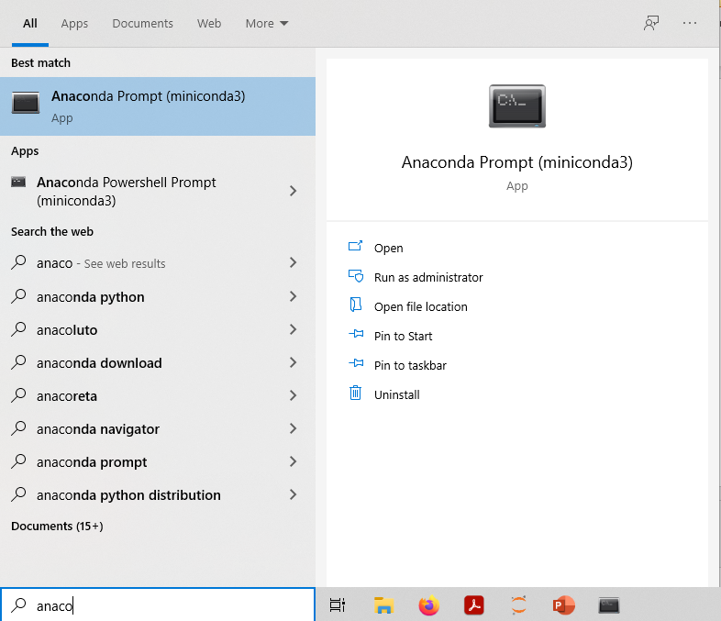

Installing Python Libraries on conda
Open Anaconda Prompt and insert «conda install library». If conda does not find the library, use «pip install library».
Trick: the first time you launch the Anaconda prompt, insert “conda config --add channels conda-forge” without the quotation marks. This will add conda-forge as a default channel, allowing conda to find many more packages. Conda-forge is a trustworthy channel. Do not download packages from channels you do not trust.

Slide 3
Installing Python Libraries on Google Colab
On Google Colab, insert «!pip install library» without the quotation marks and replacing «library» with the library you want to install, then run the cell.

Slide 4
Installing Python Libraries on Vanilla Python
On Mac:
Launch Terminal and insert «pip3 install library» without the quotation marks and replacing «library» with the library you want to install, then run the cell.
WATCH OUT!
Do NOT insert “pip install library”: you will install the library on Python 2!

Slide 5
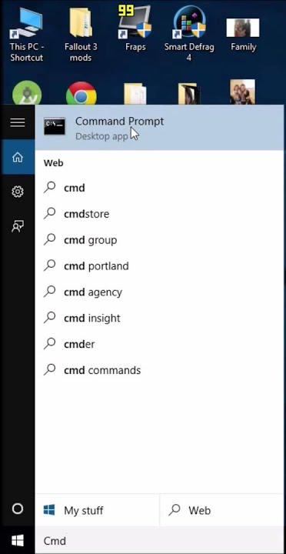
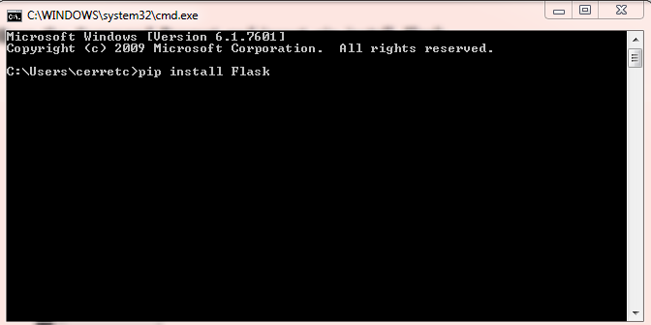
Installing Python Libraries on Vanilla Python
On Windows:
Open the Command Prompt and insert “pip install library”. If you get an error message, follow the troubleshooting on the next slides.

Slide 6
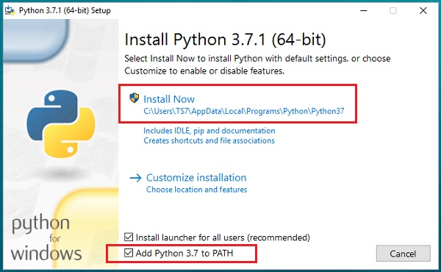
Installing Python Libraries on Vanilla Python
On Windows: If you get an error message, Python has not been added to Environment Variables.
Follow one of the 3 possible solutions:
Add Python to Environment Variables
Clean Uninstall Python, Install again and while installing CHECK ‘Add to PATH’ like shown in picture
Follow the next slides

Slide 7
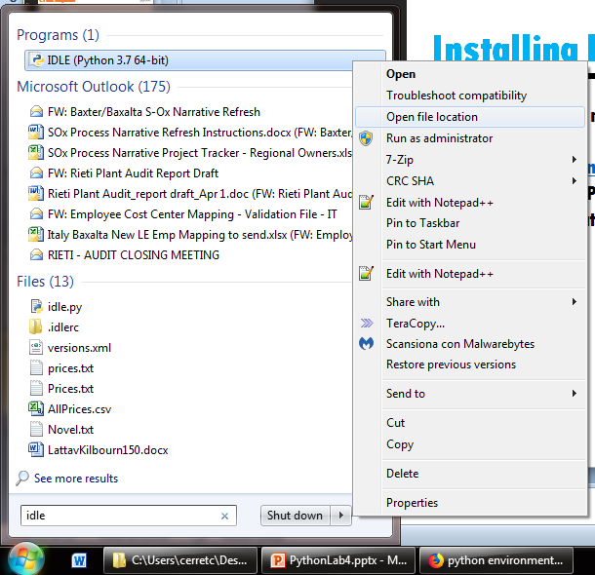
Installing Python Libraries on Vanilla Python
On Windows: If you get an error message, and you follow solution 3.
Step 1:
Open IDLE location

Slide 8
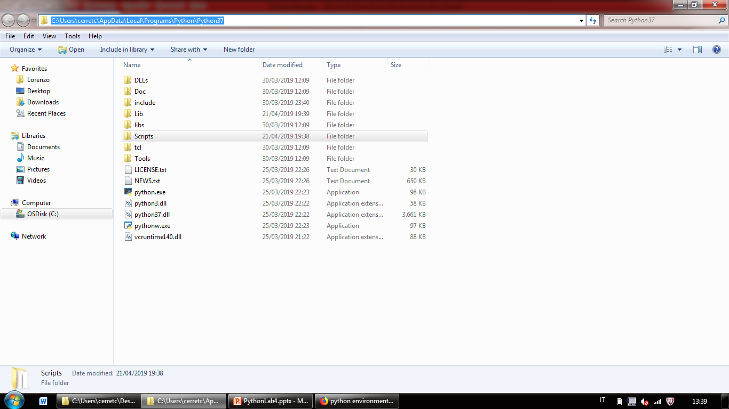
Installing Python Libraries on Vanilla Python
On Windows: If you get an error message, and you follow solution 3.
Step 2:
Copy IDLE’s folder location

Slide 9
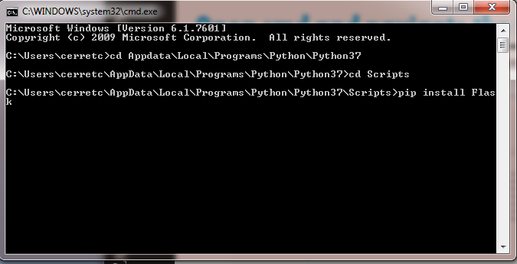
Installing Python Libraries on Vanilla Python
On Windows: If you get an error message, and you follow solution 3.
Step 3:
Open CMD and insert “cd ” and then the path you copied.
Insert “cd Scripts”.
Insert “pip install library”

